Slide 1

ANTIDERIVATIVES

Slide 2
OBJECTIVES
At the end of the lesson, the students are expected to:
know the relationship between differentiation
and integration;
identify and explain the different parts of the
integral operation; and
perform basic integration by applying the power formula and the properties of the indefinite integrals.

Slide 3
DEFINITION OF ANTIDERIVATIVE
A function F is an antiderivative of f on an interval I if F’(x)=f(x) for all x in I.
Representation of Antiderivatives
If F is an antiderivative of f on an interval I, then G is an antiderivative of f on the interval I if and only if G is of the form G(x)=F(x) + C, for all x in I, where C is a constant

Slide 4
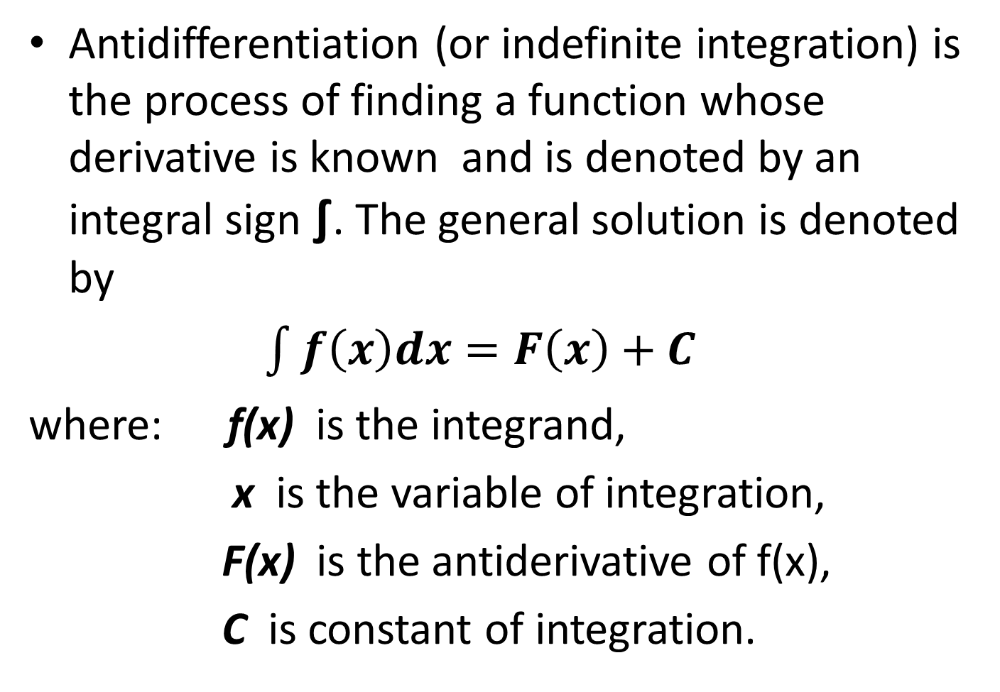
NOTATION FOR ANTIDERIVATIVES
Antidifferentiation (or indefinite integration) is the process of finding a function whose derivative is known and is denoted by an integral sign ∫. The general solution is denoted by
$\int{f\left(x\right)dx=F\left(x\right)+C}$
where: f(x) is the integrand,
x is the variable of integration,
F(x) is the antiderivative of f(x),
C is constant of integration.

Slide 5
The integral sign indicates that we are to perform the operation of integration on f(x) dx, that is, we are to find a function whose differential is f(x) dx.

Slide 6
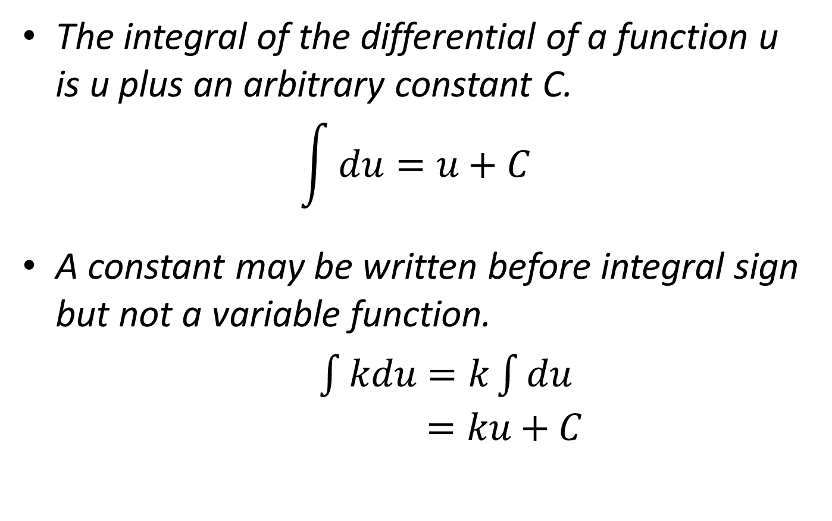
GENERAL PROPERTIES OF INDEFINITE INTEGRALS
The integral of the differential of a function u is u plus an arbitrary constant C.
$$\int{du}=u+C$$
A constant may be written before integral sign but not a variable function.
$\int{kdu}=k\int{du}$$=ku+C$

Slide 7
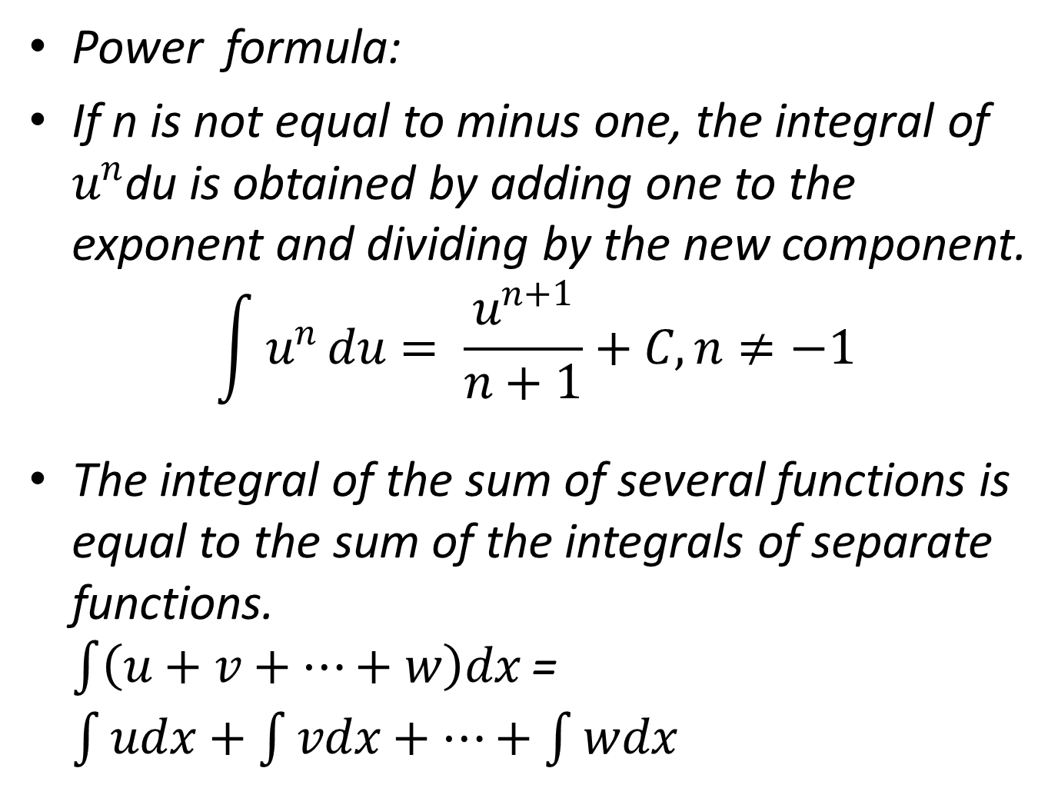
Power formula:
If n is not equal to minus one, the integral of $u^{n}$du is obtained by adding one to the exponent and dividing by the new component.
$$\int{u^{n}}du= \frac{u^{n+1}}{n+1}+C, n≠−1$$
The integral of the sum of several functions is equal to the sum of the integrals of separate functions. $\int{\left(u+v+…+w\right)dx }$= $\int{udx+\int{vdx+…+\int{wdx}}}$

Slide 8
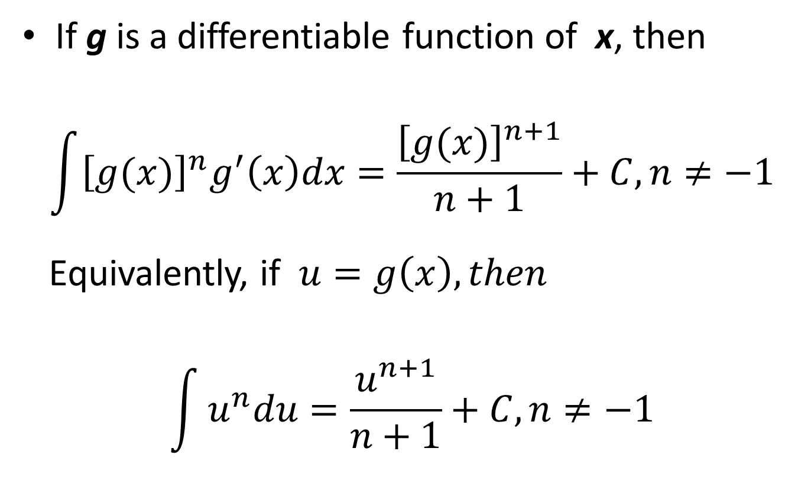
THE GENERAL POWER RULE FOR INTEGRATION
If g is a differentiable function of x, then
$$\int{{\left[g(x)\right]}^{n}g^{′}\left(x\right)dx=\frac{{\left[g(x)\right]}^{n+1}}{n+1}+C, n≠−1}$$
Equivalently, if $u=g\left(x\right), then$
$$\int{u^{n}du=\frac{u^{n+1}}{n+1}+C, n≠−1}$$

Slide 9
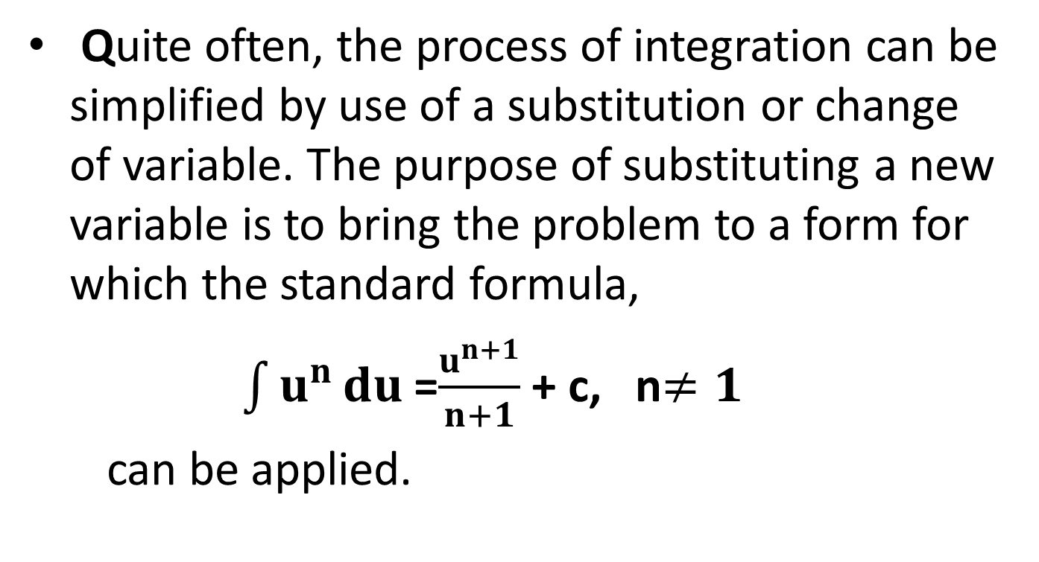
SUBSTITUTION METHOD
Quite often, the process of integration can be simplified by use of a substitution or change of variable. The purpose of substituting a new variable is to bring the problem to a form for which the standard formula,
$\int{u^{n }du }$=$\frac{u^{n+1}}{n+1}$ + c, n$≠1$
can be applied.

Slide 10
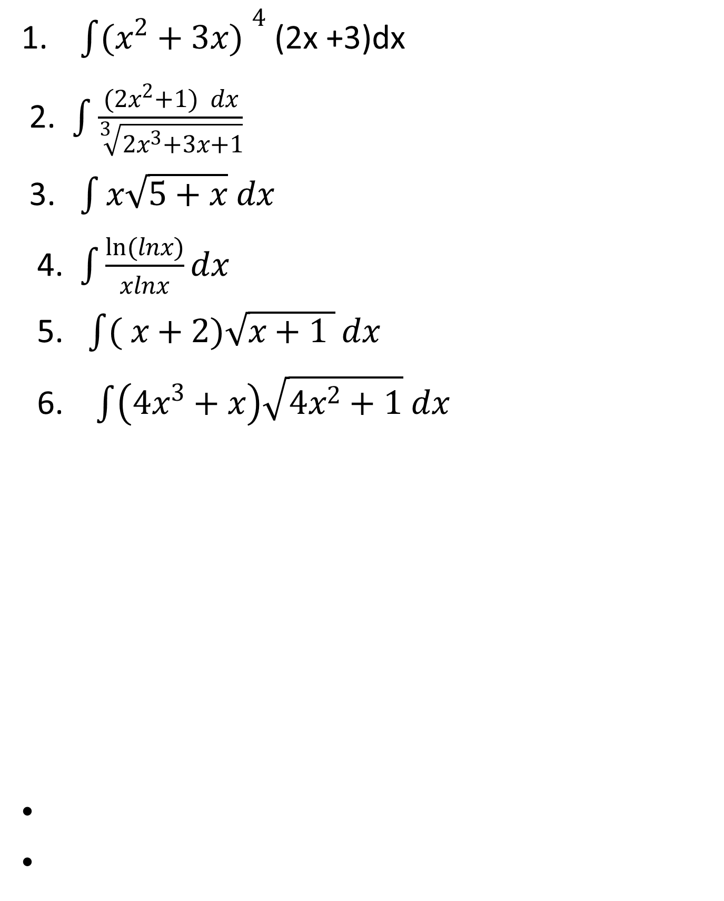
EXAMPLE: Find the indefinite integral.
1. $\int{({x^{2}+3x) }^{4}}$(2x +3)dx
2. $\int{\frac{(2x^{2}+1) dx}{\sqrt[3]{2x^{3}+3x+1}}}$
3. $\int{x\sqrt{5+x} dx}$
4.$\int{\frac{\ln{(lnx)}}{xlnx}dx}$
5. $\int{( x+2)\sqrt{x+1 }}dx$
6. $\int{\left(4x^{3}+x\right)\sqrt{4x^{2}+1} dx}$

Slide 11

7. $\int{x^{3}{(2−x^{2})}^{12}dx}$
8 $\int{\frac{\sin{\frac{1}{2}}β dβ}{{(1+5\cos{\frac{1}{2}β)}}^{2}}}$
9.$\int{\frac{\cos{2x dx}}{\sqrt{1−3\sin{2x}}}}$
10. $\int{\frac{\left(x+1\right)dx}{{(3x^{2}+6x+1 )}^{2}}}$

